Slide 1
Graph Algorithms
Group 12:
Binh Gia Huy
Tran Nhat Duc
Do Quoc Duy
Lecturer: Nguyen Thanh Son

Slide 2
Table of Contents:
Graph
Graph Traversal
Shortest-path Algorithms
Topological Sorting

Slide 3
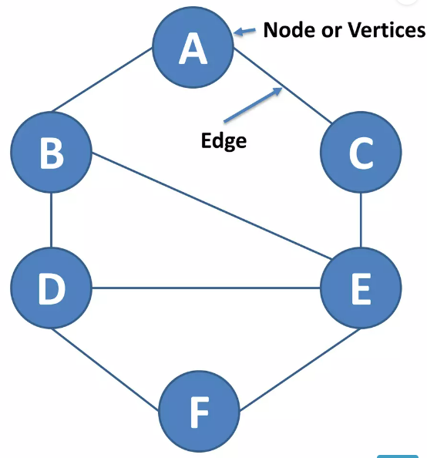
Graph
Graph data structure consists of a finite set of vertices or nodes.
The interconnected objects are represented by points termed as vertices, and the links that connect the vertices are called edges.

Slide 4
Graph
Vertex: Each node of graph is represented as a vertex.
V={A,B,C,D,E,F}
Edge: Edge represents a path between two vertices or a line between two vertices.
E={AB,AC,BD,BE,CE,DE,DF,EF}

Slide 5
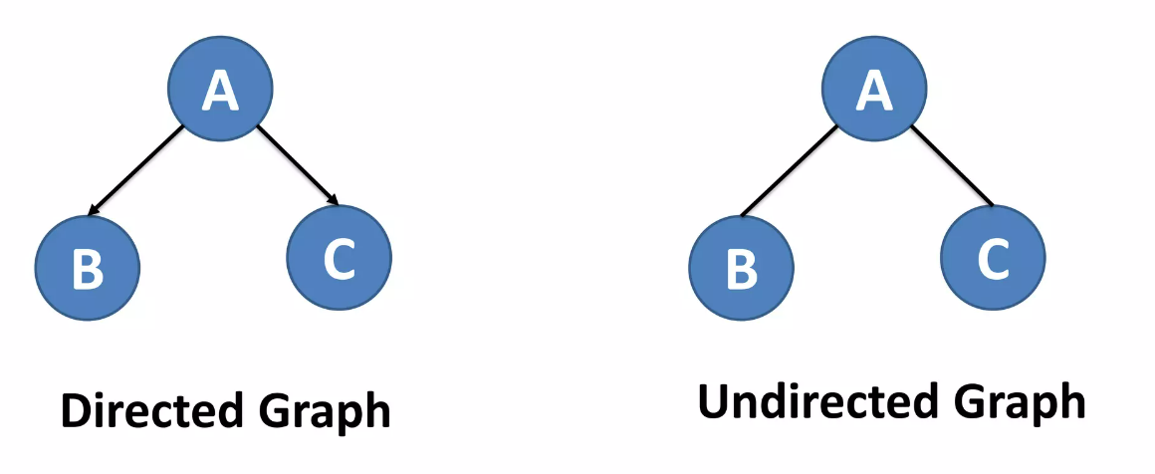
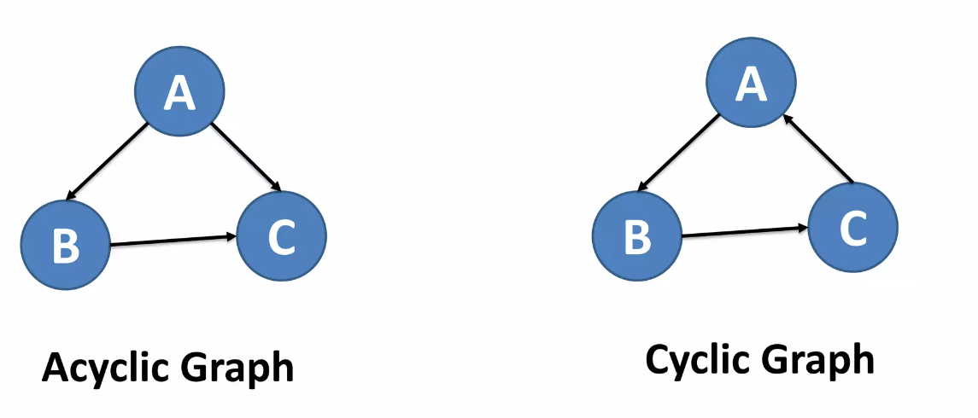
Graph

Slide 6
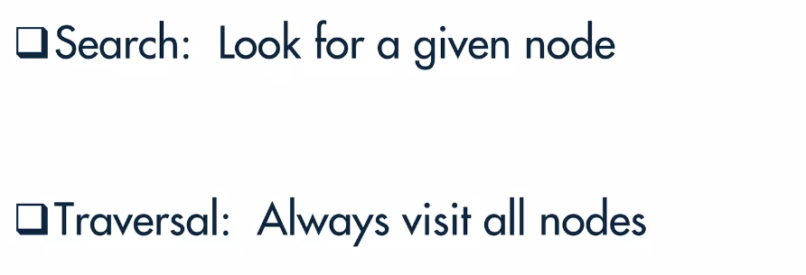
Graph Traversal

Slide 7
Graph Traversal
Breadth First Traversal
The breadth-first search (BFS) algorithm is used to search a tree or graph data structure for a node that meets a set of criteria. It starts at the tree’s root or graph and searches/visits all nodes at the current depth level before moving on to the nodes at the next depth level. Breadth-first search can be used to solve many problems in graph theory.
BFS algorithm
A standard BFS implementation puts each vertex of the graph into one of two categories:
1. Visited
2. Not Visited
The purpose of the algorithm is to mark each vertex as visited while avoiding cycles.

Slide 8
Graph Traversal
BFS Algorithm's Applications
Crawlers in search engines
For GPS navigation
Path finding algorithms
...

Slide 9
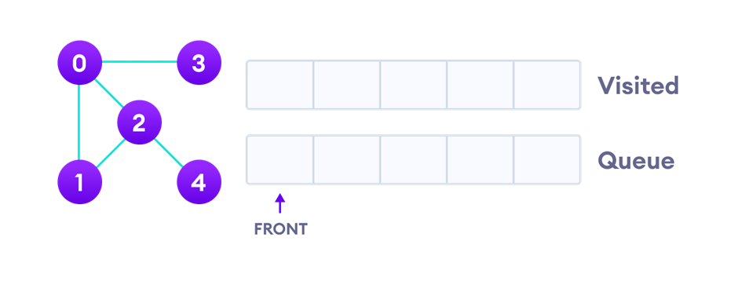
Graph Traversal
BFS example
We use an undirected graph with 5 vertices.

Slide 10
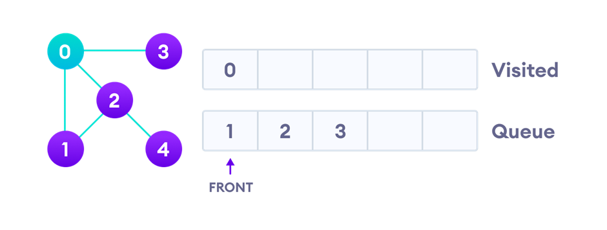
Graph Traversal
BFS example
We start from vertex 0, the BFS algorithm starts by putting it in the Visited list and putting all its adjacent vertices in the stack.

Slide 11
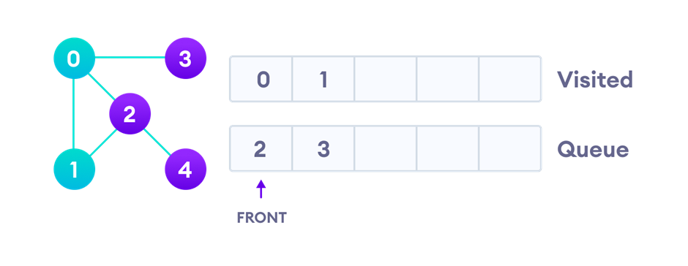
Graph Traversal
BFS example
Next, we visit the element at the front of queue i.e. 1 and go to its adjacent nodes. Since 0 has already been visited, we visit 2 instead.

Slide 12
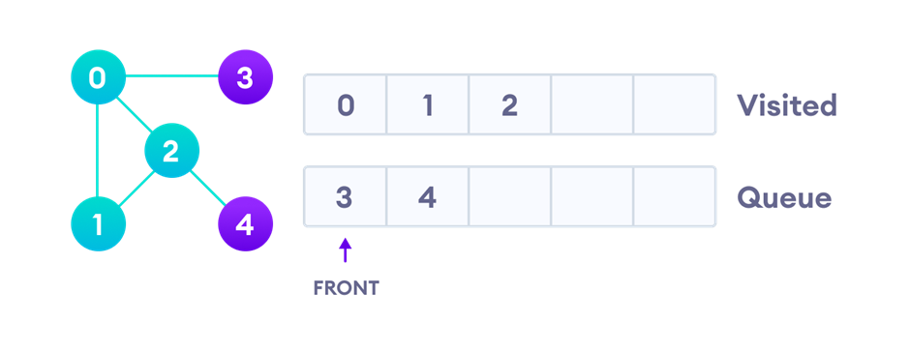
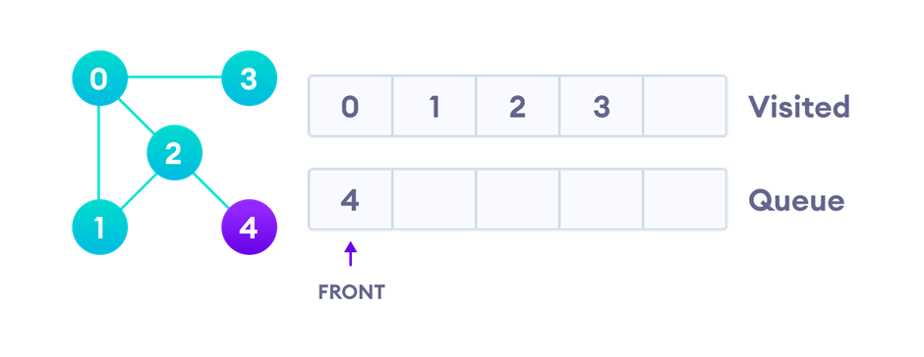
Graph Traversal
Vertex 2 has an unvisited adjacent vertex in 4, so we add that to the back of the queue and visit 3, which is at the front of the queue.
BFS example

Slide 13
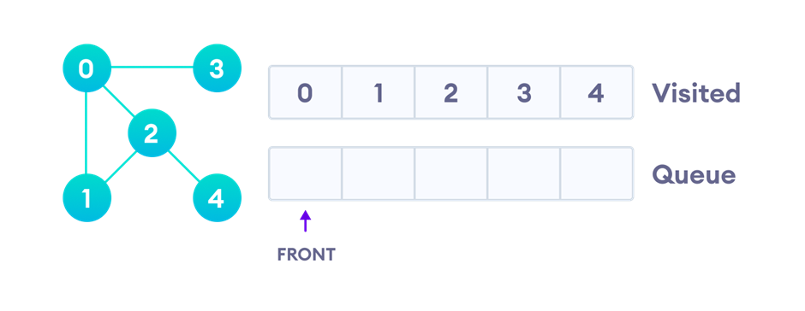
Graph Traversal
BFS example
Only 4 remains in the queue since the only adjacent node of 3 i.e. 0 is already visited. We visit it.
Since the queue is empty, we have completed the Breadth First Traversal of the graph.

Slide 14
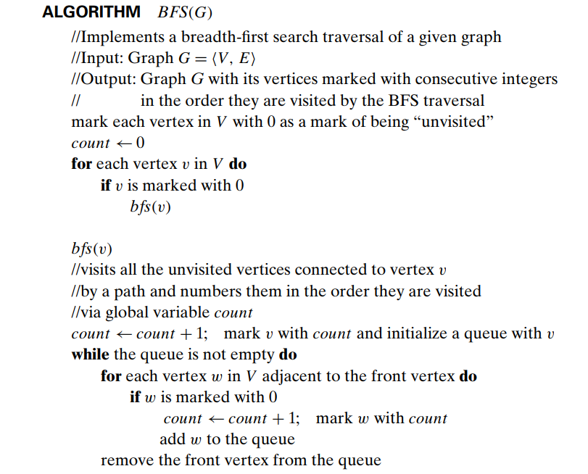
Graph Traversal

Slide 15
Graph Traversal
BFS Algorithm Complexity
The time complexity of the BFS algorithm is represented in the form of O(V+E), where V is the number of nodes and E is the number of edges.
The space complexity of the algorithm is O(V).

Slide 16
Graph Traversal
Advantages/Disadvantages:
Advantages
Never get trapped
Will find a solution if there is one
Simple
Disadvantages
Memory requirements
Can be slow

Slide 17
Graph Traversal
Depth First Search
Depth-first search (DFS) is an algorithm for searching a graph or tree data structure. The algorithm starts at the root (top) node of a tree and goes as far as it can down a given branch (path), then backtracks until it finds an unexplored path, and then explores it. The algorithm does this until the entire graph has been explored.
DFS algorithm
A standard DFS implementation puts each vertex of the graph into one of two categories:
1. Visited
2. Not Visited
The purpose of the algorithm is to mark each vertex as visited while avoiding cycles.

Slide 18
Graph Traversal
Applications of DFS Algorithm
Path finding
For finding the strongly connected components of a graph
For detecting cycles in a graph
...

Slide 19
Graph Traversal
DFS example
We use an undirected graph with 5 vertices.

Slide 20
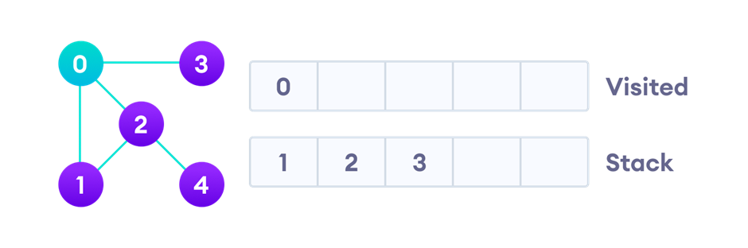
Graph Traversal
DFS example
We start from vertex 0, the DFS algorithm starts by putting it in the Visited list and putting all its adjacent vertices in the stack.

Slide 21
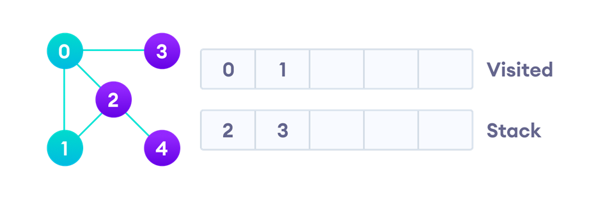
Graph Traversal
DFS example
Next, we visit the element at the top of stack i.e. 1 and go to its adjacent nodes. Since 0 has already been visited, we visit 2 instead.

Slide 22
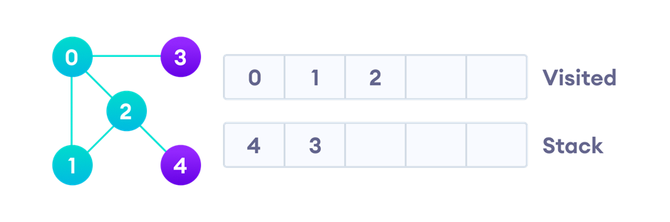
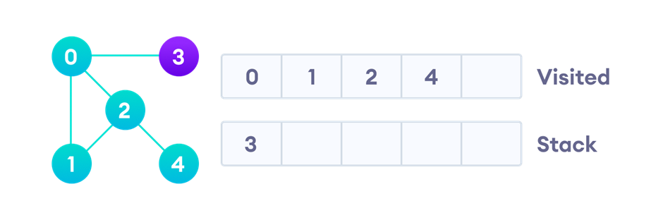
Graph Traversal
DFS example
Vertex 2 has an unvisited adjacent vertex in 4, so we add that to the top of the stack and visit it.

Slide 23
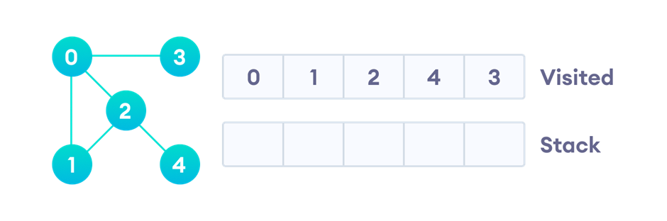
Graph Traversal
DFS example
After we visit the last element 3, it doesn't have any unvisited adjacent nodes, so we have completed the Depth First Traversal of the graph.

Slide 24
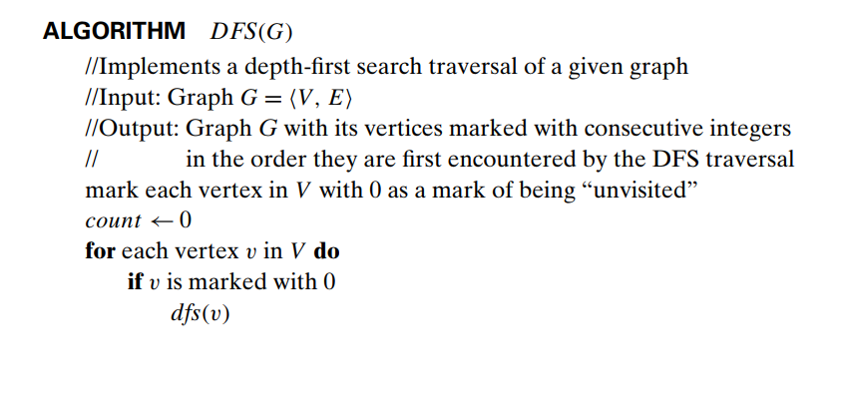
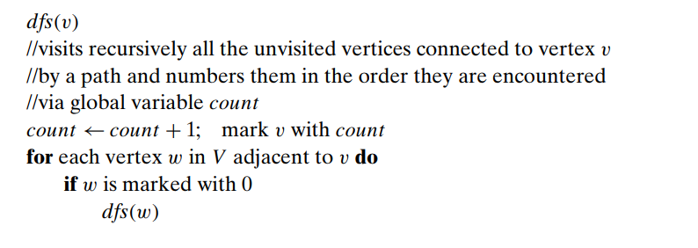
Graph Traversal
DFS Pseudocode
Crawlers in Search Engines

Slide 25
Graph Traversal
Complexity of Depth First Search
The time complexity of the DFS algorithm is represented in the form of O(V+E), where V is the number of nodes and E is the number of edges.
The space complexity of the algorithm is O(V).

Slide 26
Graph Traversal
Advantages/Disadvantages:
Advantages
Consumes less memory than DFS
It will reach at the goal node in a less time period than BFS if it traverses in a right path.
Simple
Disadvantages
May enter infinite loops
No guarantee of finding a solution

Slide 27
Shortest-path Algorithms
Floyd-Warshall Algorithm
Floyd-Warshall Algorithm is an algorithm with the main idea of gradually building up all intermedia vertices between vertices i and j to find the optimal path.
This algorithm follows the dynamic programming approach.

Slide 28
Shortest-path Algorithms
Floyd-Warshall Algorithm's Applications
Solving the all-pairs shortest path problem in weighted graphs
Finding the closest pairs of vertices in a graph
...

Slide 29
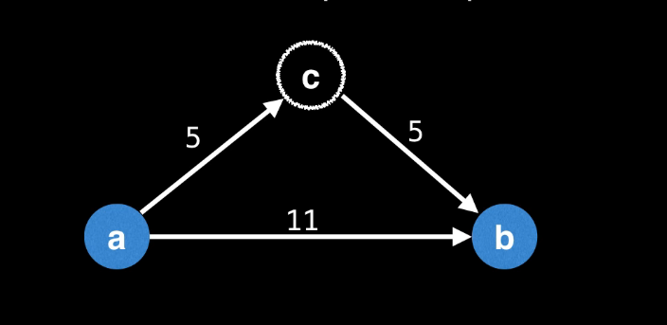
Shortest-path Algorithms
If m[a][c] + m[c][b] > m[a][b] => It’s better to go through c!

Slide 30
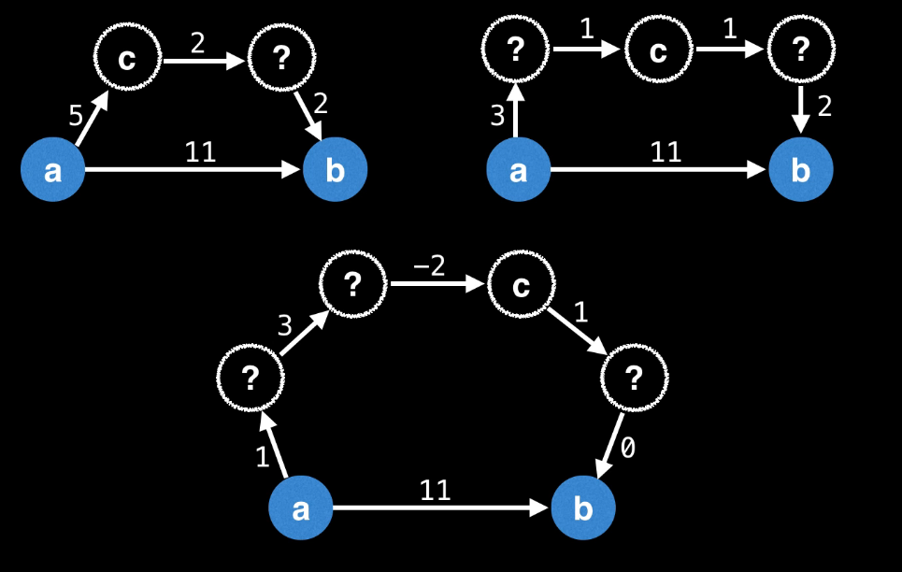
Shortest-path Algorithms
dp[i][j] = min(dp[i][j], dp[i][k] + dp[k][j])

Slide 31
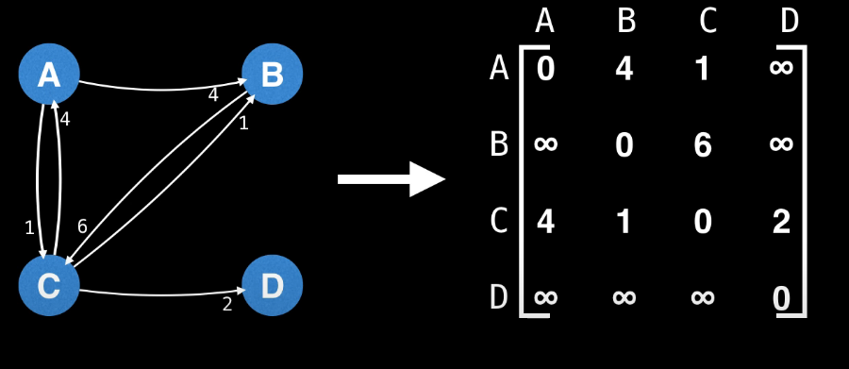
Shortest-path Algorithms

Slide 32
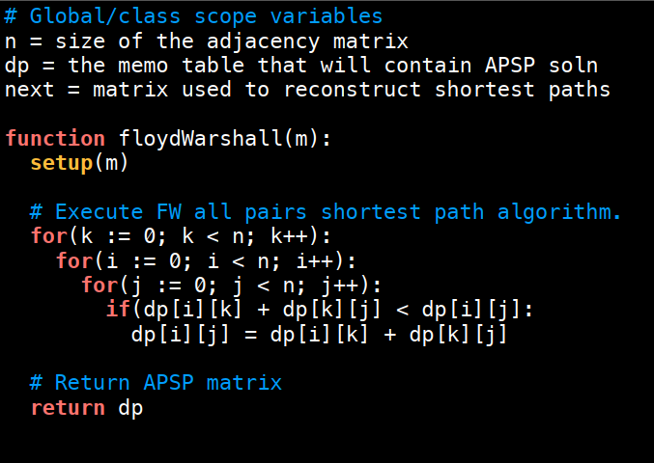
Shortest-path Algorithms
FWA Pseudocode

Slide 33
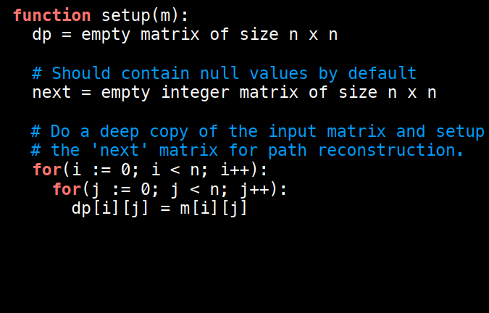
Shortest-path Algorithms
FWA Pseudocode

Slide 34
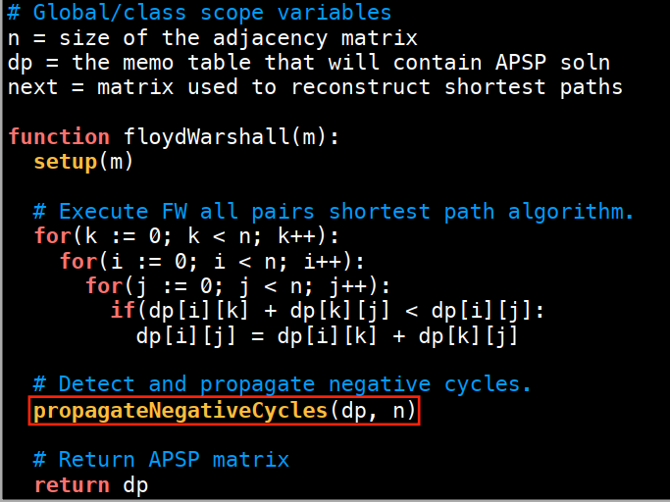
Shortest-path Algorithms
FWA Pseudocode

Slide 35
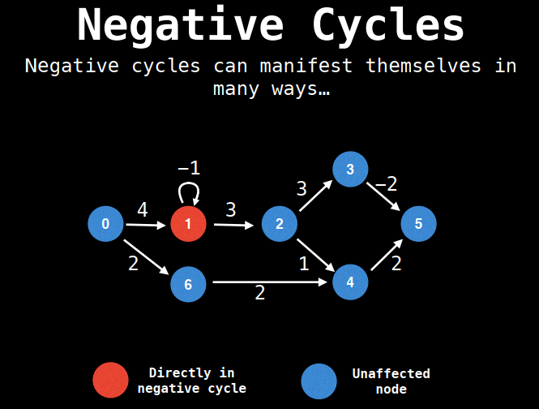
Shortest-path Algorithms
FWA Pseudocode

Slide 36
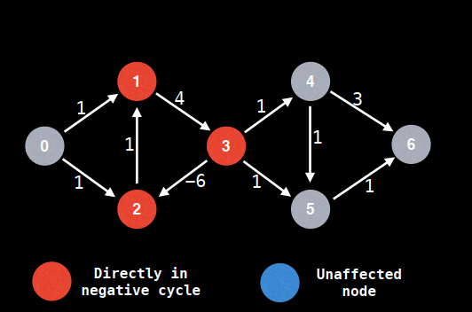
Shortest-path Algorithms
FWA Pseudocode

Slide 37
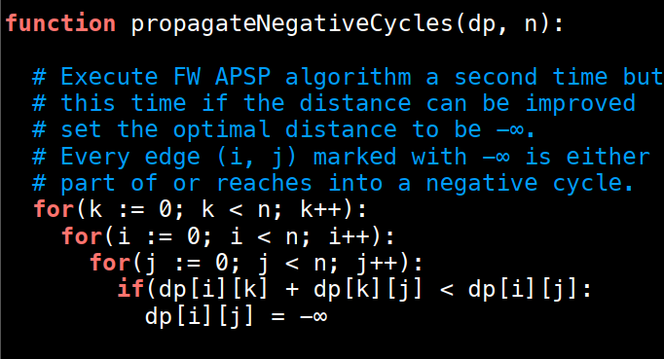
Shortest-path Algorithms
FWA Pseudocode

Slide 38
Shortest-path Algorithms
Floyd-Warshall Algorithm's Complexity
Time Complexity
There are three loops. Each loop has constant complexities. So, the time complexity of the Floyd-Warshall algorithm is O(V^3).
Space Complexity
The space complexity of the Floyd-Warshall algorithm is O(V^2).

Slide 39
Shortest-path Algorithms
Advantages/Disadvantages:
Advantages
Simple
Versatile
Efficient for small graphs
Disadvantages
Inefficient for large graphs

Slide 40
Topological Sorting
DFS-based Topological Sort
Topological ordering is an ordering of the vertices in a directed graph where for each directed edge from vertex A to vertex B, A appears before B.
Can only be used for directed acyclic graphs (DAGs).

Slide 41
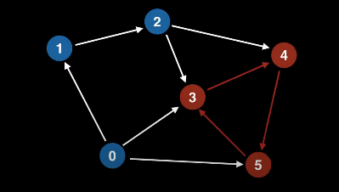
Topological Sorting
DFS-based Topological Sort

Slide 42
Topological Sorting
Topological Sorting's Applications
Class prerequisites
Programme dependencies
Assembly instruction
...

Slide 43
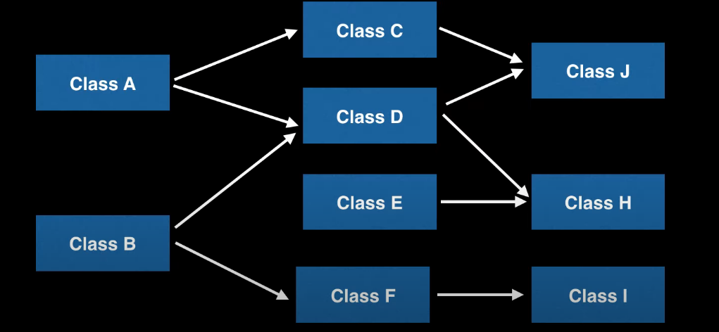
Topological Sorting

Slide 44
Topological Sorting
DFS-based Topological Sort
Steps:
Pick an unvisited vertex
Do a DFS, beginning with the selected vertex, exploring only the unvisited vertices
On the recursive call back of DFS, add that vertex to the ordering list

Slide 45
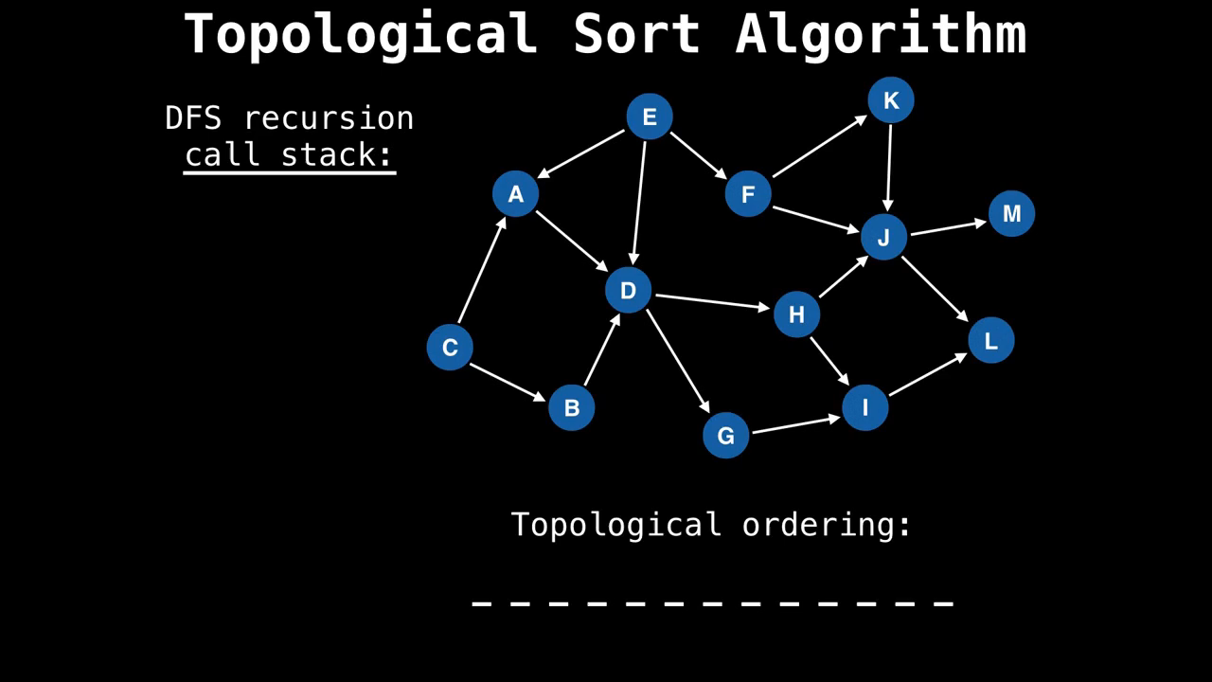

Slide 46
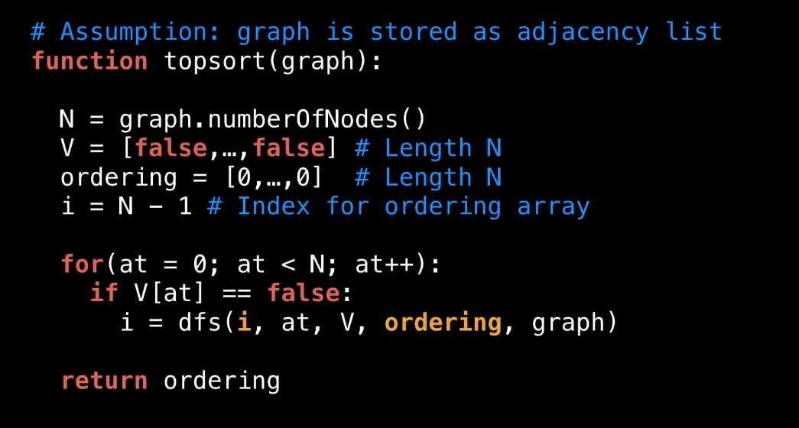
Topological Sorting

Slide 47
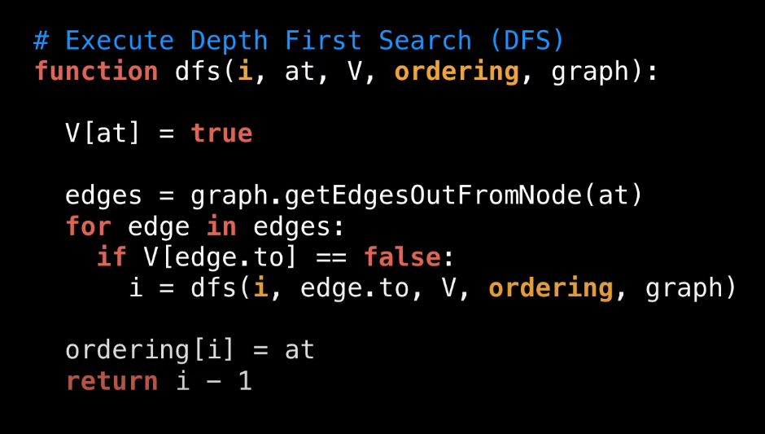
Topological Sorting

Slide 48
Shortest-path Algorithms
DFS-based Topological Sorting Algorithm's Complexity
Time Complexity
Essentially DFS so the time complexity is still O(V+E), where V is the number of nodes and E is the number of edges.
Space Complexity
O(V).

Slide 49
Shortest-path Algorithms
Advantages/Disadvantages:
Advantages
Efficient ordering.
Easy implementation using adjacency lists.
Wide range of applications.
Low time and space complexity.
Disadvantages
It only works on directed acyclic graphs (DAGs)..
This does not provide a unique solution if there are multiple valid orders for the nodes..

Slide 50
Quiz

Slide 51
End
Thank You!

Slide 52
Shortest-path Algorithms
References:
https://github.com/williamfiset/Algorithms/tree/master/slides/graphtheory
https://www.youtube.com/watch?v=4NQ3HnhyNfQ
https://www.geeksforgeeks.org/breadth-first-search-or-bfs-for-a-graph/
https://www.geeksforgeeks.org/depth-first-search-or-dfs-for-a-graph/
https://www.programiz.com/dsa/graph-dfs
https://www.programiz.com/dsa/graph-bfs
https://www.geeksforgeeks.org/difference-between-bfs-and-dfs/
Floyd-Warshall Algorithm (programiz.com)
Floyd Warshall Algorithm | DP-16 - GeeksforGeeks
Anany Levitin, Introduction to the Design and Analysis of Algorithms, 3rd Edition, 2014

Slide 53
Shortest-path Algorithms
References:
Floyd-Warshall Algorithm (programiz.com)
Floyd Warshall Algorithm | DP-16 - GeeksforGeeks
Anany Levitin, Introduction to the Design and Analysis of Algorithms, 3rd Edition, 2014

